Slide 1
Algebraic Expressions
The Number System
Geometry
Measurement and Data
Ratios and Proportions
10
10
10
10
10
20
20
20
20
20
30
30
30
30
30
40
40
40
40
40
50
50
50
50
50

Slide 2
Category 1 questions follow

Slide 3
Category 1
What is the value of x which makes the equation true?
2x = 16
32
8
18
14
10

Slide 4
Category 1
B. 8
2x = 16
$÷$ 2 $÷$ 2
x = 8
check
2(8) = 16
10

Slide 5
Category 1
Please choose the correct answer for the problem below.
y + 173 = 226
170
172
53
174
20

Slide 6
Category 1
C. 53
y + 173 = 226
– 173 – 173
y = 53
check
53 + 173 = 226
20

Slide 7
Category 1
Please choose the correct answer for the problem below.
x + ( 34 + 8 ) = 56
14
70
96
98
30

Slide 8
Category 1
A. 14
x + ( 34 + 8 ) = 56
x + ( 42 ) = 56
– 42 – 42
x = 14
check
14 + ( 34 + 8 ) = 56
14 + ( 42) = 56
30

Slide 9
Category 1
Please choose the correct answer for the problem below.
y ÷ 3 = 33
30
36
11
99
40

Slide 10
Category 1
D. 99
y ÷ 3 = 33
x 3 x 3
y = 99
check
99 ÷ 3 = 33
40

Slide 11
Category 1
Please choose the correct answer for the problem below.
( 91 – 3 ) ÷ x = 11
- 77
88
8
99
50

Slide 12
Category 1
C. 8
( 88 ) ÷ x = 11
11x = 88
x=8
check
( 88 ) ÷ 8 = 11
50

Slide 13
Category 2 questions follow

Slide 14
Category 2
What is the greatest common factor for 8 and 12?
A. 1
B. 2
C. 4
D. 24
10

Slide 15
Category 2
C. 4
Factors 8: 2 x 2 x 2
Factors 12: 2 x 2 x 3
Greatest Common Factor: 2 x 2 = 4
10

Slide 16
What is the least common multiple for 9 and 6?
A. 1
B. 3
C. 18
D. 36
20

Slide 17
Category 2
C. 18
Multiples of 9: 9, 18
Multiples of 6: 6, 12, 18
Least Common Multiple: 18
20

Slide 18
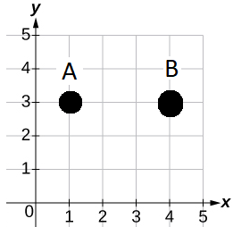
Category 2
The distance between points A and B is…
A. 4
B. 1
C. 2
D. 3
30

Slide 19
Category 2
D. 3
4 – 1 = 3
30

Slide 20
Category 2
A. 4
B. 3
C. 32
D. 64
40

Slide 21
Category 2
A. 4
40

Slide 22
Category 2
A. 3
B. 6
C. 18
D. 54
50

Slide 23
Category 2
B. 6
50

Slide 24
Category 3 questions follow

Slide 25
Category 3
Julie has a 4’ by 5’ rectangle shaped piece of wood. What is the area for this rectangle shaped wood in square feet?
A. 10
B. 9
C. 18
D. 20
10

Slide 26
Category 3
D. 20
4 x 5 = 20
10

Slide 27
Category 3
Tanya has a plastic pink right triangle with a length of 5 centimeters and a height of 10 centimeters. What is the area of this right triangle in square centimeters?
A. 15
B. 25
C. 50
D. 75
20

Slide 28
Category 3
B. 25
20

Slide 29
Category 3
Joey has two rectangle shaped rugs with the dimensions of 7” x 11”. What is the total area, in square inches, for the two rugs?
A. 38.5
B. 77
C. 144
D. 288
30

Slide 30
Category
C. 144
(7 x 11) x 2 = 77 x 2 = 144
30

Slide 31
Category 3
Mrs. Johnson cut a 6” by 6” cake exactly in half. She ate the first half, but left the second half for her friend. What is the area of the second half of cake in square inches?
A. 6
B. 18
C. 36
D. 9
40

Slide 32
Category 3
B. 18
(6 x 6)/ 2 = (36)/2 = 18
40

Slide 33
Category 3
Jacque cut three 4” by 6” triangles out of cardboard. What is the total area of all three triangles in square inches?
A. 12
B. 36
C. 72
D. 24
50

Slide 34
Category 3
B. 36
50

Slide 35
Category 4 questions follow

Slide 36
Category 4
Please choose the correct answer to make the conversion below true.
___ pounds = 32 ounces
5
2
7
8
10

Slide 37
B. 2
1 pound = 16 ounces
2 pounds = 2(16)= 32 ounces
10

Slide 38
Category 4
Please choose the correct answer to make the conversion below true.
___fluid ounces = 4 cups
8
16
24
32
20

Slide 39
Category 4
D. 32
8 fluid ounces = 1 cup
8 x 4 = 32
20

Slide 40
Category 4
Please choose the correct answer to make the conversion below true.
___kilograms = 220 pounds
100
200
440
484
30

Slide 41
Category 4
A. 100
1 pound = 2.2 kilograms
220 $÷$ 2.2 = 100
30

Slide 42
Category 4
Please choose the correct answer to make the conversion below true.
___miles = 400 kilometers
A. 100
B. 112.72
C. 248
D. 645.16
40

Slide 43
Category 4
C. 248
0.62 miles = 1 kilometer
400 x 0.62 = 248
40

Slide 44
Category 4
Please choose the correct answer to make the conversion below true.
___ inches = 9 meters
A. 36
B. 354.33
C. 0.29
D. 19.8
50

Slide 45
Category 4
B. 354.33
39.37 inches = 1 meter
39.37 x 9 = 354.33
50

Slide 46
Category 5 questions follow

Slide 47
Category 5
Billy can dig five holes in six hours. How many holes can he dig in eighteen hours?
15
30
21
25
10

Slide 48
Category 5
A. 15
10

Slide 49
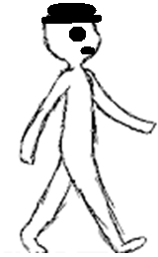
Category 5
Dexter walks eight miles in two hours. How far does he walk in miles in three hours?
A. 36
B. 8
C. 24
D. 12
20

Slide 50
Category 5
D. 12
20

Slide 51
Category 5
A machine produces fifteen plastic bricks every five seconds. Approximately, how many plastic bricks will be made in 1 minute?
A. 5
B. 180
C. 20
D. 360
30

Slide 52
Category 5
B. 180
1 minute = 60 seconds
30

Slide 53
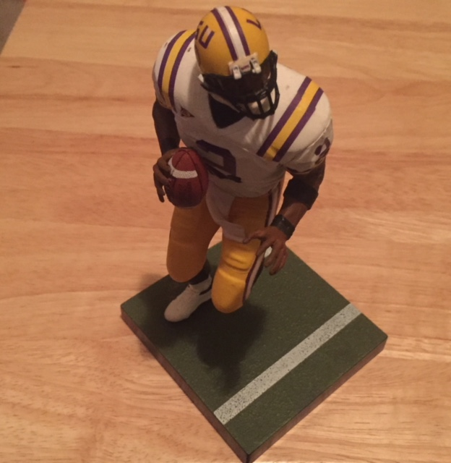
Category 5
A toy store sells a bag of six mixed action figures for $2.94. What is the unit cost of a single action figure in the bag?
A. $0.24
B. $1.47
C. $0.98
D. $0.49
40

Slide 54
Category 5
D. $0.49
$2.94 $÷$ 6 = $0.49
40

Slide 55
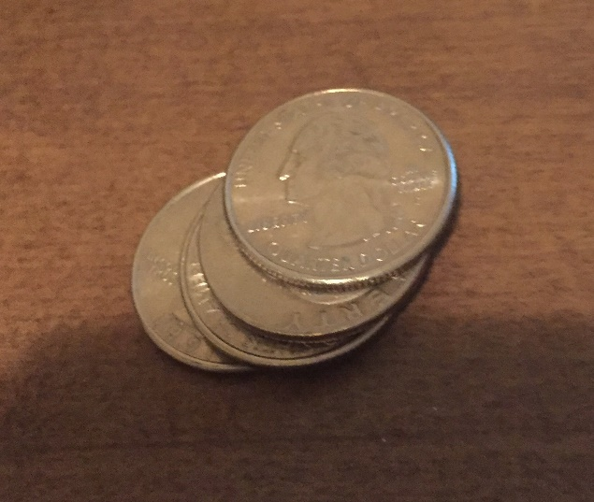
Category 5
Roger collects quarters. He keeps his favorite 12 quarters in a box in his room. This is 6% of his collection. How many total quarters are in his collection?
A. 7
B. 100
C. 200
D. 20
50

Slide 56
Category 5
C. 200
12 $÷$ 0.06 = 200
Check
200 x 0.06 = 12
50

